Slide 1

Data Pipeline and Quality Management week 3
Sai krishna reddy m

Slide 2
Pipeline Overview extraction raw data from the relational database. Transformations like removing duplicates, handling missing values, outlier detection and removing them applied on the data set. Storing clean data in a new schema.
Notes:
Extraction of Raw Data:
I begin by extracting raw data from a relational database.
This could be done using queries to pull relevant tables and data extraction.
Data Transformation:
Once extracted, the data needs to be cleaned and prepared for analysis.
Key transformations include:
Removing duplicates to avoid redundancy.
Handling missing values, either by filling them with appropriate values (imputation) or removing incomplete rows/columns.
Detecting and removing outliers, which could otherwise distort analysis and modeling.
Storing Clean Data:
After transformation, the cleaned data is stored in a new schema within the database.

Slide 3
Pipeline Selection Selected Batch pipeline Process. The dataset is static and does not require real-time processing. And batch processing allows transformation, cleaning, and feature engineering. It ensures consistency and quality checks before ingestion into storage. Data Storage Format Selection The selected data storage format is Parquet. Parquet is a columnar storage format optimized for analytical queries. It provides better compression, reducing storage space requirements. Suitable for large-scale machine learning tasks and distributed processing.
Notes:
Pipeline Selection
For this data processing workflow, we have chosen a Batch Processing Pipeline instead of a real-time streaming pipeline.
Why Batch Processing
Batch processing enables structured data transformation, cleaning, and feature engineering in a controlled manner.
This approach ensures data consistency and quality checks before ingestion into storage, reducing errors and improving reliability.
2. Data Storage Format Selection
The selected data storage format is Parquet, a widely used columnar storage format.
Why Parquet?
Optimized for Analytical Queries: Since it stores data in a columnar format, it improves performance for analytical workloads.
Efficient Compression: Parquet applies advanced compression techniques, reducing storage space and improving read performance.

Slide 4
Pipeline Diagram PostgreSQL (raw.iris_data) │ ▼ Data Cleaning Steps - Missing Values Check - Duplicate Removal - Outlier Handling │ ▼ Feature Engineering │ ▼ PostgreSQL (cleaned.iris_data) │ ▼ Postgre
Notes:
Overview of the Pipeline
1. Data Source: PostgreSQL (raw.iris_data)
The pipeline starts with PostgreSQL, where the raw dataset (raw.iris_data) is stored.
At this point, the data can have missing values, duplicates, and outliers and needs preprocessing for analysis.
2. Data Cleaning Steps
Raw data extracted goes through necessary cleaning activities to enhance data quality
Missing Values Check: It detects and processes incomplete records. Missing values can be imputed (filled) or deleted based on severity.
Duplicate Removal: It makes sure there are no duplicate records that could mislead analysis.
Outlier Handling: Detects and removes anomalies that can affect modeling accuracy.
3. Feature Engineering
After cleaning, feature engineering is next, where new variables or transformed features are created to improve model performance.
Examples:
Creating new calculated fields (e.g., petal-to-sepal ratio).
Encoding categorical variables for better processing.
Normalizing or scaling numeric values for machine learning models.
4. Storing Cleaned Data: PostgreSQL (cleaned.iris_data)
Once transformed, the cleaned dataset is stored once more in PostgreSQL with a new schema/table named (cleaned.iris_data). It is best to keep the raw and cleaned datasets separated for data tracking and comparison if needed.
5. Next Steps: Utilizing the Data The cleaned dataset is now ready to use for analysis, visualization, and machine learning modeling. If required, it can also be inserted into a batch or real-time processing system for automation.

Slide 5
Data Quality Issues Missing Values : Find or checking for missing values if any found solving them Duplicates : Detected and removed duplicate values with drop_duplicates() Outliers: outliers are identified and removed using method IQR method Categorical variable : converting categorical variable to numerical variable Feature Engineering : Found new feature with the help of feature engineering Feature scaling : Feature scaling is the process of normalizing or standardizing numerical features
Notes:
1. Handling Missing Values
I first looked for missing values in the data.
Missing values can result from incomplete data capture, system glitches, or manual entry errors.
2. Removing Duplicates
Duplicate records may occur due to data merging, system issues, or human error. Duplicates will distort analysis and produce incorrect conclusions. Solution: We identify and eliminate duplicates by utilizing the drop_duplicates() function from pandas to ensure that every record is unique.
3. Outlier Detection and Removal
Outliers are data points that are significantly different from the others. If not addressed, they will alter statistical analysis and machine learning algorithms. Solution:
We implement the Interquartile Range (IQR) method for outlier detection and removal.
4. Transforming Categorical Variables into Numerical Format
Machine learning algorithms generally expect numerical input, and thus categorical variables have to be transformed.
5. Feature Engineering
Feature engineering is creating new variables to improve the performance of models.
Example:
If we have a dataset with height and weight, we can create a new feature BMI (Body Mass Index) as:
This helps in getting more meaningful information from the data.
6. Feature Scaling (Normalization/Standardization)
Feature scaling puts numerical features on the same scale, which enhances model performance.

Slide 6
Data Validation And Checking Missing Values Check : Checking missing values if any with isnull().sum(). Duplicates Detection: Detected duplicates if any with duplicated().sum().
Notes:
1. Missing Value Checking
Why check for missing values?
Missing data can cause biased conclusions and affect the performance of machine learning models.
How do we check for missing values?
We utilize the isnull().sum() pandas function to check the count of missing values in every column.
2. Finding Duplicate Values
Why check for duplicates?
Duplicate records can result in data redundancy, miscalculation, and biased results.
How do we find duplicates?
We utilize duplicated().sum() in pandas to find duplicate entries in the data.

Slide 7
A Plan To Detect Data Drift Or Schema Change Over Time Regular monitoring of statistical distributions with change in time. Checking regularly for significant deviations. Checking for incoming data that matches the existing data format and type before it is getting processed.
Notes:
1. Monitoring Statistical Distributions
Monitor important statistics such as mean, variance, and distribution changes in data on a regular basis.
Abnormal changes can signal data drift, which can affect model predictions.
Visualization (e.g., histograms, box plots) are used to monitor the changes.
2. Detecting Significant Deviations
Establish acceptable deviation thresholds.
Create automatic alerts to inform when data moves away from expected trends.
3. Schema Validation
Validate incoming data against the expected structure, types, and constraints prior to processing.
Utilize schema validation tools to implement automated checks.
Prevents problems such as missing fields, datatype mismatches, or unexpected column alterations.

Slide 8
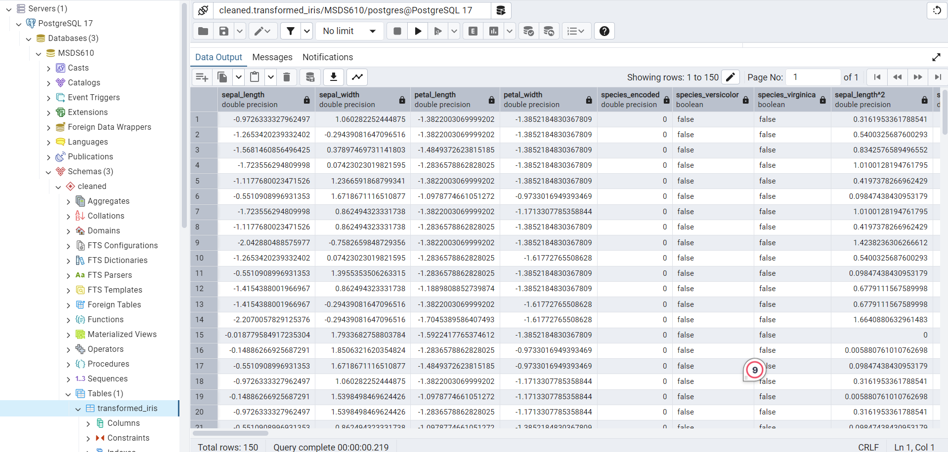
Screenshot Of Loaded Data
Notes:
This is the screen shot storing the data in cleaned schema. It is done with all the pipelining steps like cleaning the data outliers handling duplicates removal.

